Slide 1
Human Impact on Climate Change
Student’s Name:
Institutional Affiliation

Slide 2
INTRODUCTION
Human impact during this era has been one of the driving forces to climate change.
Daily activities have been causing changes in the atmosphere of the earth in the production of greenhouse gases that contributes highly to global warming.
This presentation will explore the daily activities that have adverse effects on the environment, related statistics and ways of mitigating the menace.

Slide 3
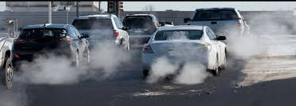
EVERYDAY ACTIVITY
Our lifestyle in the modern era impacts our environment in different or numerous ways.
There are so many activities that influences or causes change in our climate change. The activity that I have decided to choose is driving cars. (Picture)

Slide 4
REASONS FOR CHOOSING THE DRIVING VEHICLES
The reason as to why I choose driving as the activity that I think mostly influences or causes changes to the environment is because driving is one of the most common and prevalent activities that is done 24 hours in a day, 7 days in a week.
In other words, in every second, millions of cars are being driven across the world.
This form of activity greatly causes devastative impacts to the environment.

Slide 5
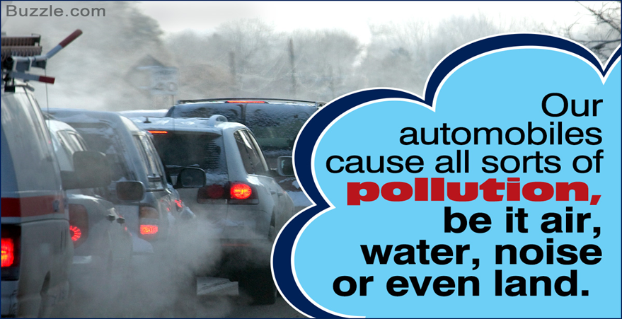
RATIONALE FOR THE ACTIVITY
Driving is one of the primary means that people have a preference of when undertaking their daily activities.
It is important to note that vehicles produce a third of the air pollution in the United States.
Notes:
In accordance with the Environmental Protection Agency, one vehicle emits over 4.6 tons of carbon dioxide annually.
Most of the people only have the knowledge that vehicles affect the quality of the air but do not realize its contribution to pollution.

Slide 6
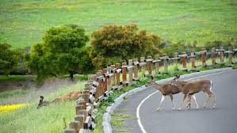
DISRUPTION TO HABITAT
Roads are major causes of habitat loss, degradation, fragmentation among others.
Linear infrastructure is vital for the community as it offers connectivity for the people.
Ecological effects of roads and traffic on the adjacent habitats is rampant (Van der Ree et al., 2011).

Slide 7
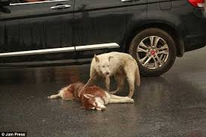
IMPACTS ON WILDLIFE
Vegetation adjacent to the roads infrastructure usually offers habitat and in some of the cases, the majority of the habitat.
Wildlife that will use these surroundings will experience motor vehicle traffic noise and may be affected by it.
Driving cars has been the cause of the death for most animals
Notes:
Anthropogenic noise has the capability of disrupting severely the communication of the species by acoustic masking or interferences. For instance, a study conducted by Parris and Schneider (2008) discovered that Grey Shrike-thrush (Bird) sang in regions with traffic noise at a higher frequency as compared to Grey Fantail and probability of detecting either of the species substantially declined with increasing traffic volume and noise (Parris & Schneider, 2009).

Slide 8
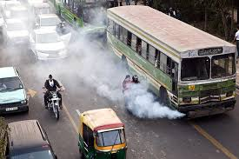
EFFECTS ON THE ENVIRONMENT
Global Warming
Cars and trucks emit carbon dioxide and other numerous greenhouse gases contributing to 20 percent of the global warming pollution in the United States.
Notes:
Greenhouses gases usually trap the heat in the atmosphere which leads to a rising in temperature across the globe. The burning of fossil fuels such as diesel or gasoline causes an increase in temperature by 0.6 degrees delicious and continue to increase in the coming decades (Green, 2018).

Slide 9
EFFECTS OF THE ENVIRONMENT CONT:
Air, Soil and Water
Nitrous Oxide from cars or vehicle emissions contributes significantly to the Ozone layer depletion.
Nitrogen Dioxide and Sulfur dioxide mixes with water to form acid rain.
Oil spills from the vehicles contaminate water
Notes:
Ozone layer guards the earth against Ultraviolet sun radiation which is harmful.
Acid rain causes devastating effects to the environment such as damaging forests, crops and buildings.
Fuel and oil spills from trucks and cars percolate into the soil adjacent to the highways. Discarded fuels or Oil spills from transit shipping contaminate rivers, lakes, wetlands and ocean (Green, 2018).

Slide 10
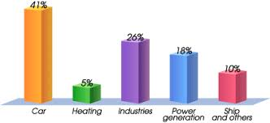
Statistics On The Effects On The Environment
In the year 2016, EPA showed that emission of green house gases from transportation in the United States amounted to averagely 28.5 percent of the total emissions of green house gases (United States Environmental Protection Agency, 2018).
Research indicates that the number of animal killed in the United States is estimated to be 1 million every day (Seiler & Helldin, 2006).
Over 350,000 to 27 million birds have been killed in the European roads each year (Erritzoe, Mazgajski, & Rejt, 2003).

Slide 11
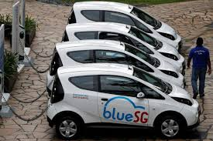
Action To Decrease The Impact On The Environment
Use of electric, hybrid and clean fuel efficient motor vehicles rather than using the old and poor serviced vehicles reduces the environmental impacts.
Car-pooling is another strategy of reducing environmental impact. Using public means of transport instead of using personal cars also reduced the impact greatly.
Changing driving habits
Notes:
Change in our daily driving habit can greatly reduce pollution to the environment such as;
Switching off the engine when it is parked saves fuel and reduces pollution.
Using other alternative such as cycling or walking for the shorter journey will not only reduce the devastating impacts on the environment but it will also be good for your health.
Routine maintenance of the vehicle helps in reducing the impact of the vehicle on the quality of the air

Slide 12
CONCLUSION
In as much as we may not avoid or replace our locomotive ability as humans, we, however, need to change some of the habits to make our environment better.
Driving vehicles has impacts on animal's habitats, global warming and pollution to water, air and soil among others.
Strategies to reduce the impact would use of electric and hybrid vehicles and use of other modes of transportation such as public means transportation and carpooling.

Slide 13
References
Erritzoe, J., Mazgajski, T. D., & Rejt, Ł. (2003). Bird Casualties on European Roads — A Review. Acta Ornithologica, 38(2), 77-93. doi:10.3161/068.038.0204
Green, J. (2018, March 13). Effects of Car Pollutants on the Environment. Retrieved from https://sciencing.com/effects-car-pollutants-environment-23581.html
Parris, K. M., & Schneider, A. (2009). Impacts of Traffic Noise and Traffic Volume on Birds of Roadside Habitats. Ecology and Society, 14(1). doi:10.5751/es-02761-140129
Seiler, A., & Helldin, J. O. (2006). Mortality in wildlife due to transportation. The Ecology of Transportation: Managing Mobility for the Environment, 165-189. doi:10.1007/1-4020-4504-2_8
United States Environmental Protection Agency. (2018, October 9). Sources of Greenhouse Gas Emissions. Retrieved from https://www.epa.gov/ghgemissions/sources-greenhouse-gas-emissions
Van der Ree, R., Jaeger, J. A., Van der Grift, E. A., & Clevenger, A. P. (2011). Effects of Roads and Traffic on Wildlife Populations and Landscape Function: Road Ecology is Moving toward Larger Scales. Ecology and Society, 16(1). doi:10.5751/es-03982-160148

